Slide 1
GROUP 3
YAKUB ISMAIL IMRAN
OYENIYI ELIZABETH
BAKARE OLALEKAN

Slide 2
EXECUTIVE SUMMARY
We worked on a dataset called supermarket sales data which has data from 3 cities/branches from which customers of different types came to buy products using 3 different modes of payment.
The objective is to analyze the supermarket sales data across the three cities and make recommendations on how to boost sales across the different product-line in the various cities.
Out of the three cities Naypyitaw city had the highest revenues of sales with females being the most buyer.

Slide 3
DATA SET DESCRIPTION
We explored the data for insights by first carrying out data cleaning and understanding, during the process, there were no missing cells found and most of the data were in object data-type with ‘column Date’ changed to ‘datatime’
The Data has 1000 rows and 17columns which was later cleaned to have 15 columns and 1000 rows, The data is unique and doesn’t have empty cells.
Further cleaning was done by changing some column names for better understanding E,g ( ‘cogs’ was renamed to cost of goods sold, some columns were dropped )
The data given include: Invoice no, cities(yagon, naypidaw,mandalay) , branches(A,B,C), gender(Male, female), customertype(member / normal) product line( about 6), date , time, payment, cost price and total.

Slide 4
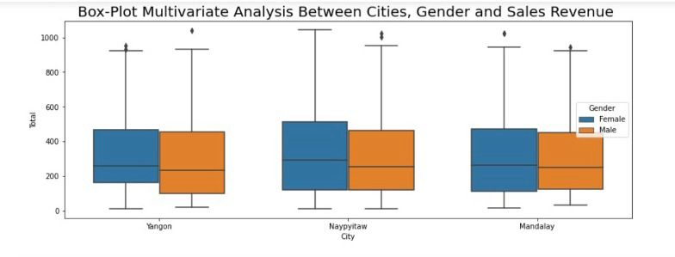
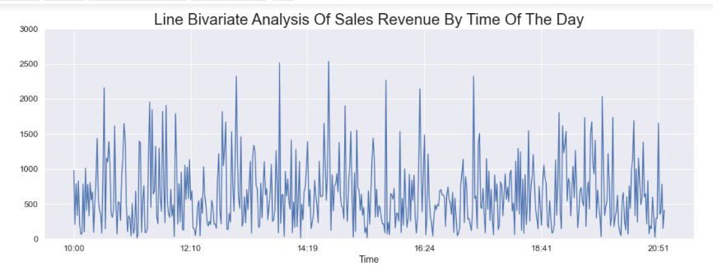
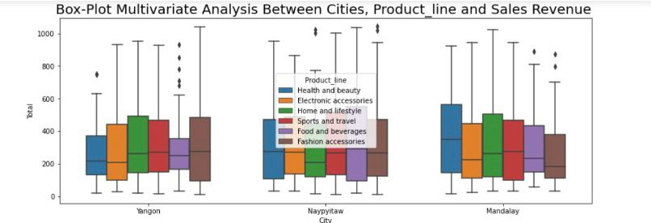
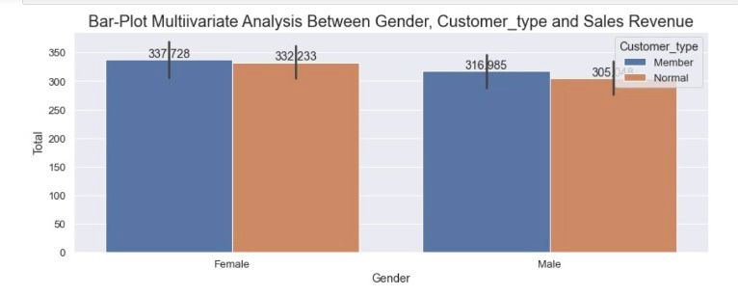
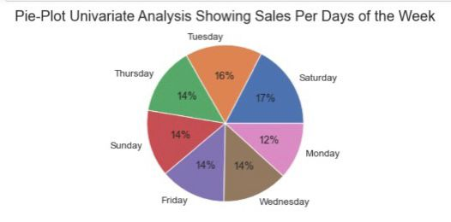
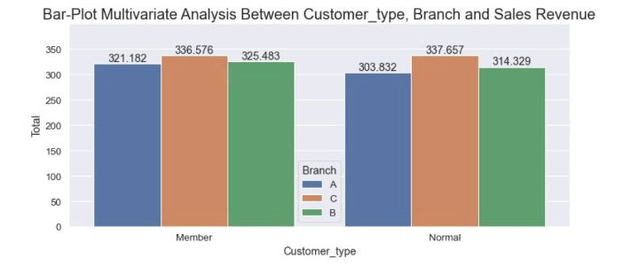
VISUALIZATION

Slide 5
CONCLUSION
Percentage of female customers buying products from the supermarket was relatively higher than that of male customers in all the locations. Napyitaw was the location with the highest sales revenue.
Customer type under the member’s category accounts for a larger percentage than that of normal customer types in sales revenue.
Saturday and Tuesday have the highest sales revenue between the hours of 2 pm to 4 pm. Therefore, it is recommended that Sales promotion and advertisement be targeted on Saturday and Tuesday between the hours of 2pm to 4pm to boost sales revenue.
Further insights can be explored in the notebook - https://github.com/lamibakers/SUPERMARKET-SALES-EXPLORATORY-DATA-ANALYSIS

